Slide 1

Ramadan UPDATE

Slide 2

GMSA’s invitation: Ramadan Conference
9th March
Venue: National Mosque, Kawukudi - Accra
Capacity: 20 people
6 executives, 7 males and 7 females
Alhassan Issah (General Organizer) to take list of people who want to go for the program
Habiba (Women Organizer) ) to take list of boys who want to go for the program
Iftar: Decision on having iftar together
Busy Schedule: Observe Iftar individually or in smaller group
Alternatively: There will be dates and fruits in the mosque
One alumni has promised to provide fruits and dates

Slide 3

SLE rules: Use of the kitchen in our hostel
Use Microwave for its intended purpose
Use the kettle for boiling water
Let’s follow the directive so that we are not accused of using Ramadan as an excuse to bend the rules

Slide 4
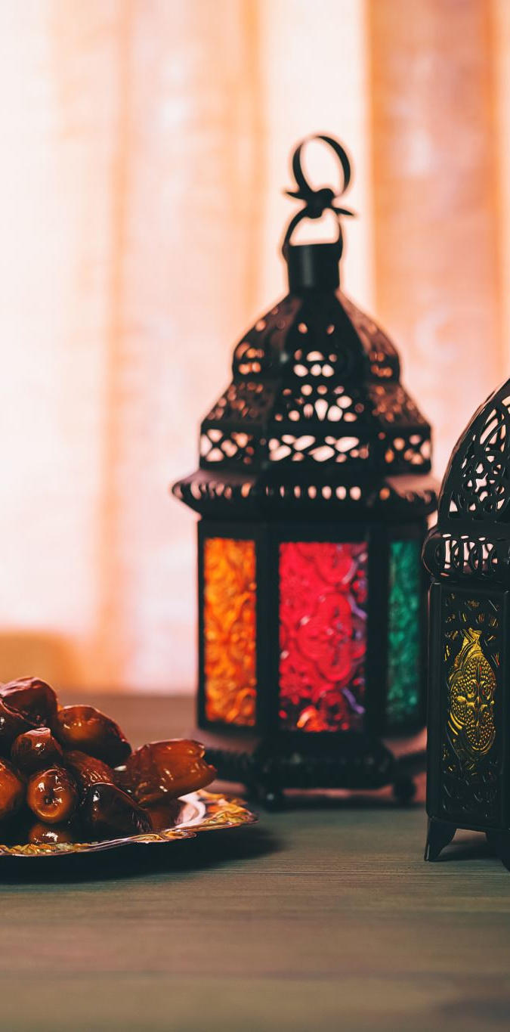
Eidul Fitr: Pray on the hill or go to Accra to pray?
We need to fund our transport costs
We are planning to have a little celebration
We have to fund ourselves
If everyone has no objection, we will pay GHS 100 each
Payment begins from the 1st day of Ramadan to the 15th day
All payments should be made to Morro Sulleyman (Finance Secretary)

Slide 5

Ablution location – Increase in Masjid attendance
Our numbers in the mosque will increase during Ramadan
We need to use the space outside to create more room for everyone to pray with us
We should cease performing ablution right outside the Masjid
Its preferrable to perform ablution before coming to the mosque
For those who need to perform ablution, fill in water into the kettles and walk to the drying line closer to the masjid to perform wudu

Slide 6
WALAIKUM SALAM WARAHMATULLAHI WABARAKATUHU

